Slide 1
LAB 2: SHELL PROGRAMMING
Preeti Thareja

Slide 2
Problems to be Solved
a) Write A Shell Program of Hello World
b) Write a shell program to find factorial of a number.
c) Write a shell program to find gross salary of an employee.
d) Write a shell program to display the menu and execute instructions accordingly
(i)List of files (ii)Process Status (iii) Date (iv) users in program (v) Quit

Slide 3
vi editor
Visual editor
default editor that comes with the UNIX operating system is called vi
Used for editing an existing file or create a new file from scratch or to read an existing file

Slide 4
To open vi editors
vi [file_name]
This will open a file in vi editor by the name file_name. If file exists it will open that and if not it will open a new file.
To create a script
vi [file_name].sh
Making script executable
chmod +x [file_name].sh
Making script executable
chmod +x [file_name].sh
Runing the script
./[file_name].sh or sh [file_name].sh or bash [file_name].sh

Slide 5
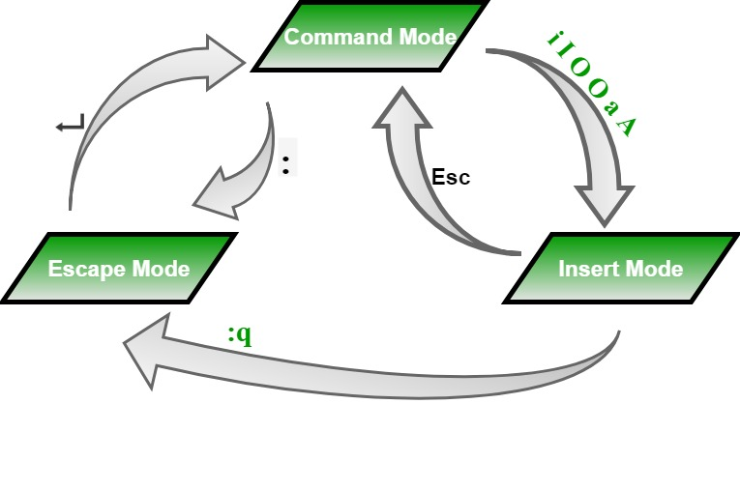
Modes

Slide 6
Command Mode
When vi starts up, it is in Command Mode.
This mode is where vi interprets any characters we type as commands and thus does not display them in the window.
This mode allows us to move through a file, and delete, copy, or paste a piece of text.
Enter into Command Mode from any other mode, requires pressing the [Esc] key.
If we press [Esc] when already in this Command Mode, then vi will beep or flash the screen.

Slide 7
Input or Insert Mode
This mode enables you to insert text into the file.
Everything that’s typed in this mode is interpreted as input and finally, it is put in the file.
The vi always starts in command mode.
To enter text, you must be in insert mode. To come in insert mode, you simply type i.
To get out of insert mode, press the Esc key, which will put you back into command mode.

Slide 8
Escape Mode
Line Mode is invoked by typing a colon [:], while vi is in Command Mode.
The cursor will jump to the last line of the screen and vi will wait for a command.
This mode enables you to perform tasks such as saving files and executing commands.
:q only quit
:q! quit without saving
:wq write and quit

Slide 9
IF command
FORM 1 If [ command ] then execute commands else execute commands fi | FORM 2 If [ command ] then execute commands fi | FORM 3 If [ command ] then execute commands elif [ command ] then execute commands . . else ..... fi

Slide 10
Operators
Operator Meaning
-eq Equal to
-ne Not equal to
-gt Greater than
-ge Greater than or equal to
-lt Less than
-le Less than or equal to

Slide 11
CASE command
case “expression” in
pattern1) commands;;
pattern2) commands;;
pattern3) commands;;
*) default commands;;
esac

Slide 12
While
For
while [ condition ]
do
commands;
done
for variable in list
do
commands;
done

Slide 13
Program to fine the largest of three numbers
echo Enter the numbers to be compared: ;
read a;
read b;
read c;
if [ $a -ge $b ] && [ $a -ge $c]
then
echo largest number is $a;
elif [ $b -ge $a ] && [ $b -ge $c ]
then
echo largest number is $b;
else
echo largest number is $c;
fi

Slide 14
Program to perform operations selected by the user
echo '\t\t\t\t'MENU;
echo '\t\t\t'1.Today\'s Date;
echo '\t\t\t'2.Time;
echo '\t\t\t'3.List files;
echo '\t\t\t'4.Users of System;
echo '\t\t\t'5.Calender;
echo Enter your choice : ;
read ch;
case $ch in
1) date +"%d/%m/%Y";;
2) date +"%I:%M:%S";;
3) ls -l -f;;
4) who -H;;
5) echo Enter the month and year you want;
echo month: ; read m;
echo year: ; read y;
cal -m $m $y;;
*) echo Wrong choice...;;
esac

Slide 15
LAB WORK: FORMAT
Question
Shell Program
Output screenshot

